Slide 1


REVANTH REDDY YAKKANTI
Superstore Sales Dashboard
Task 3 – Dashboard Design | Data Analyst Internship

Slide 2

Introduction: Power BI Dashboard for Superstore Sales
01
03
Objective & Tools Used
Dashboard Screenshot
Designed an interactive sales dashboard using Power BI to visualize business performance using Superstore data.
Snapshot of the final Power BI dashboard displaying real-time visuals and interactive features.
02
04
KPIs, Charts & Filters Used
Key Business Insights
Used KPIs, charts, and slicers to highlight sales trends, category performance, and regional distribution.
Identified key patterns in sales performance—such as top-selling categories, regions, and seasonal trends.

Slide 3
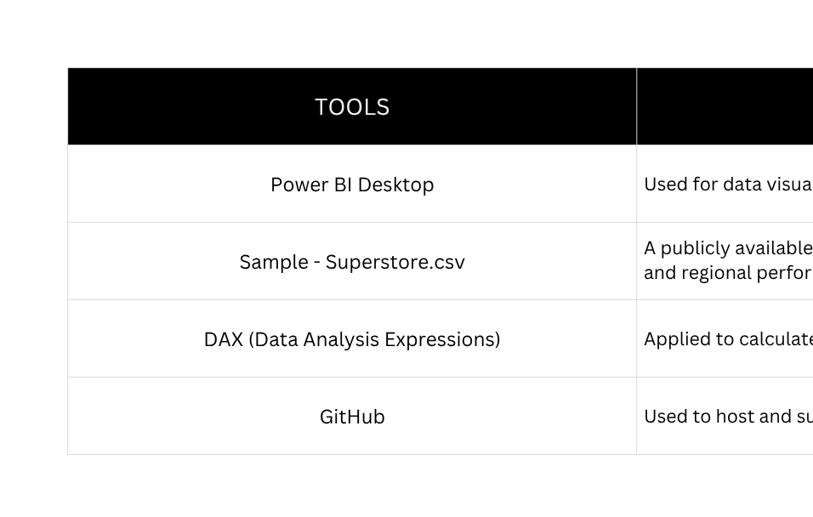
Objective & Tools Used
To design a dynamic and interactive dashboard that provides business stakeholders with clear visibility into sales performance, category trends, and regional insights using the Superstore dataset.
OBJECTIVE

Slide 4

KPIs, Charts & Filters Used
Key Performance Indicators (KPIs):
Charts Used:
Filters (Slicers) Used:
Line Chart – To show sales trend over time (Order Month-Year).
Bar Chart – Sales by Category to compare high-performing categories
Column Chart – Sales by Sub-Category to dig deeper into product-level insights.
Pie Chart – Distribution of sales across Regions.
Map Visual – Geographical distribution of sales by State.
Segment – Customer type filter (Consumer, Corporate, Home Office).
Category – Product category filter (Furniture, Office Supplies, Technology).
Region – Geographic filter to analyze regional performance.
Order Year – Filter to select and compare performance across years.
Total Sales – Sum of sales across all orders.
Total Orders – Count of unique Order IDs
Total Customers – Number of distinct customers.
Total Products Sold – Count of unique Product IDs.

Slide 5
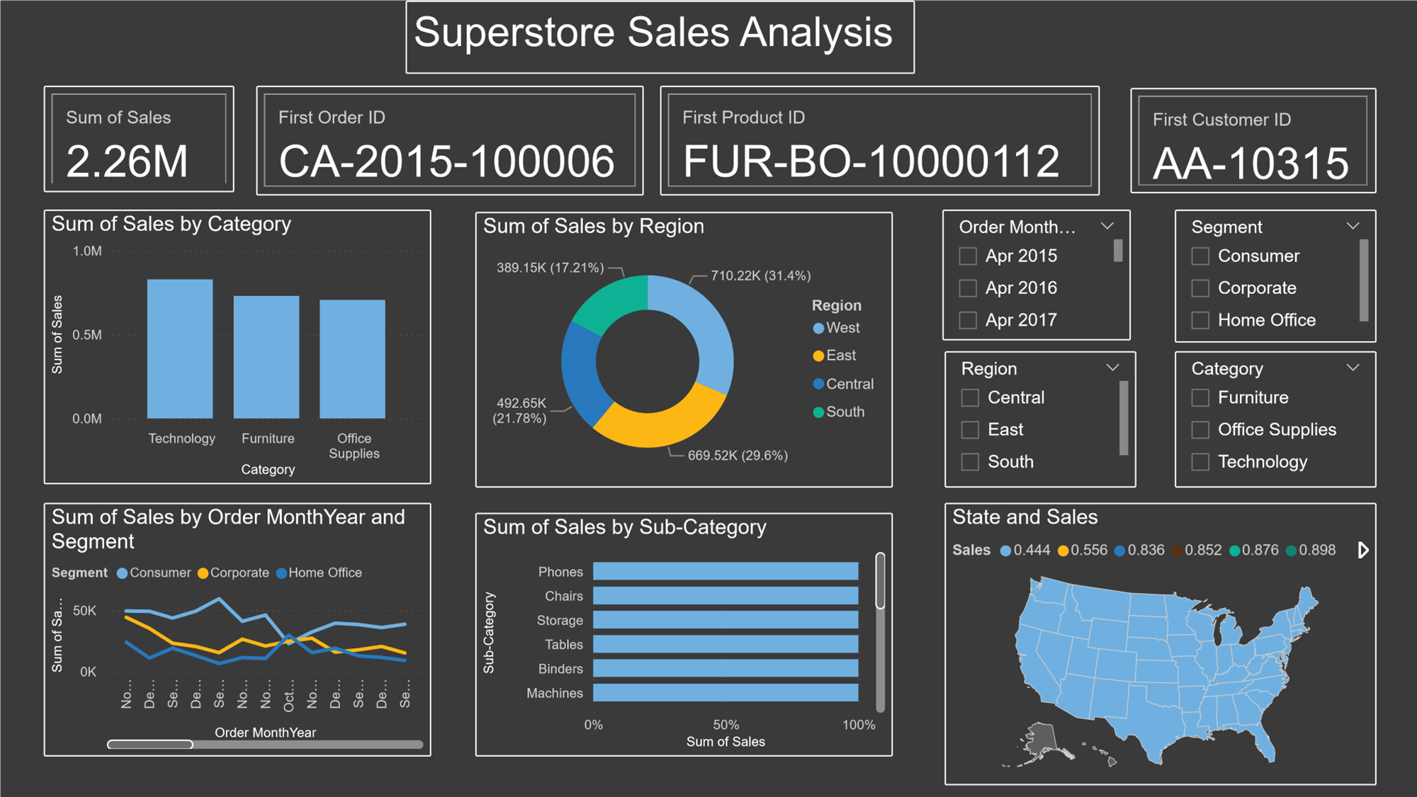
Dashboard Screenshot

Slide 6

Key Business Insights
1. Technology is the leading category in terms of total sales, followed by Office Supplies and Furniture.
2. The West region contributes the highest sales, while the South region shows potential for growth with fewer orders but consistent revenue.
3. California consistently outperforms other states, making it the top-performing region across all categories.
4. Most purchases are made by the Consumer segment, indicating strong engagement from individual customers.
5. Sales see a noticeable peak during November and December, hinting at a holiday season impact or end-of-year bulk orders.

